Slide 1



Get consent from your partner

Slide 2

Why is consent important?

Slide 3
Look at the wrapper
Check the expiry date
Make sure there’s an air bubble in it

Slide 4
What can happen if a condom has expired or there’s no air bubble in it?

Slide 5
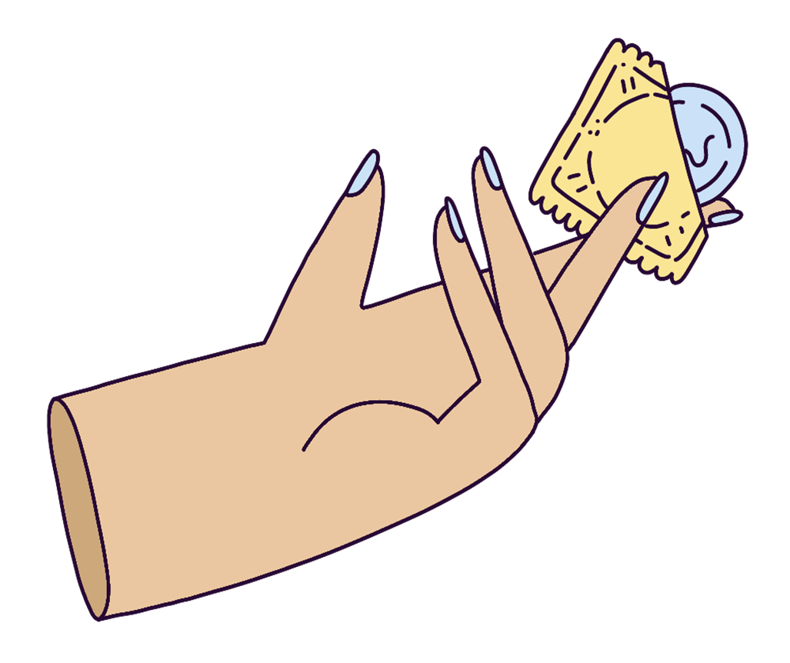
Open the condom packet carefully and remove condom

Slide 6

Why be careful when opening a condom packet?

Slide 7
Check condom is around the right way for unrolling

Slide 8
Which way is the right way?
What should you do if you put a condom on the wrong way?

Slide 9
Squeeze the tip of the condom to remove air

Slide 10
Why is it important to remove air from the condom?

Slide 11
While holding the tip, place condom on top of penis/toy/etc

Slide 12


Slide 13
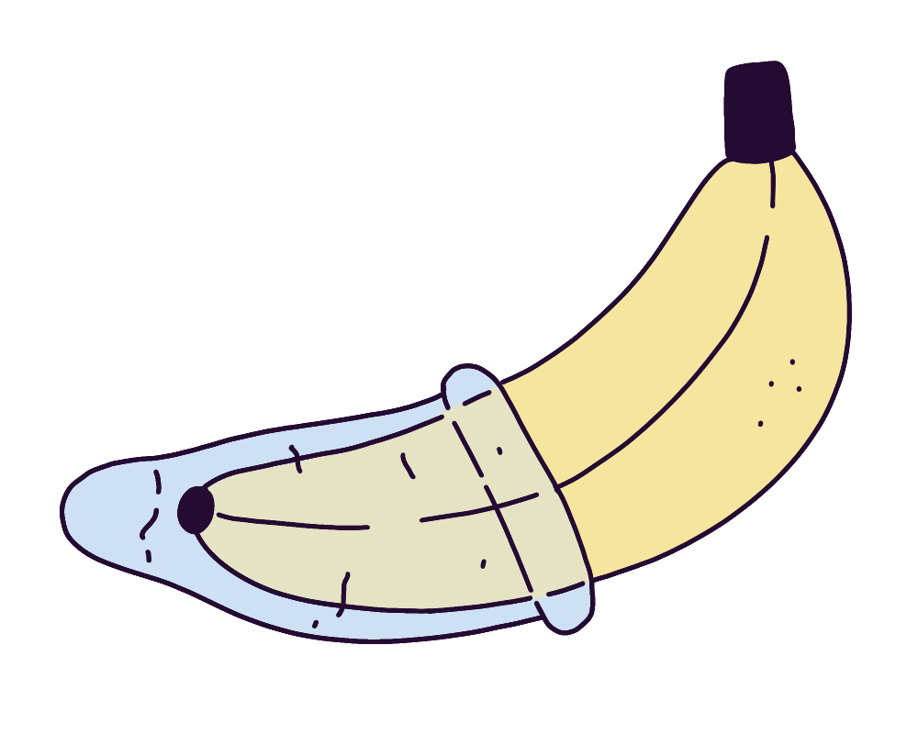
Roll condom down the entire length of penis/toy/etc

Slide 15
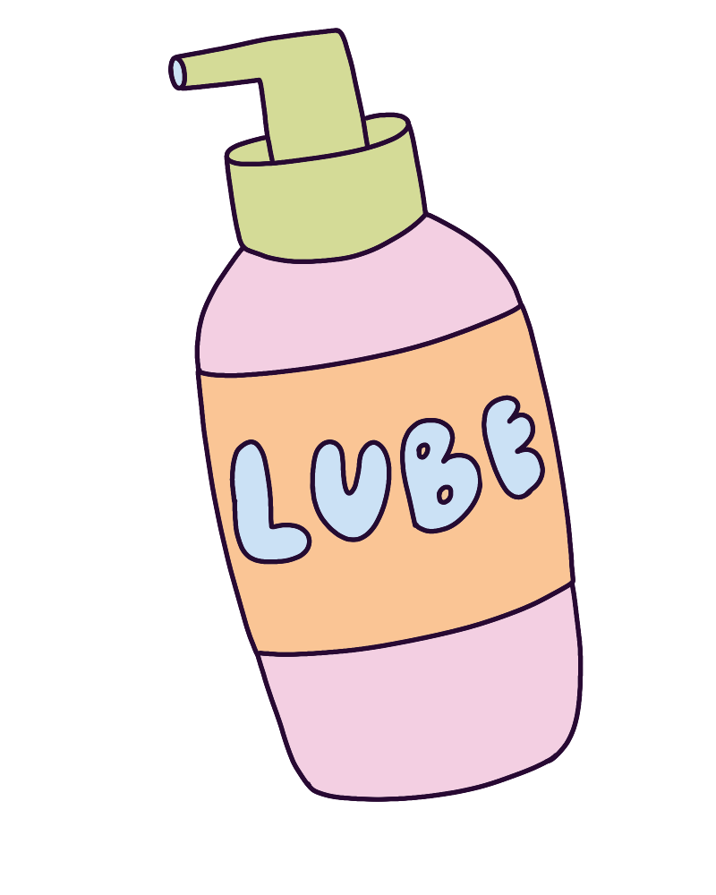
Apply water-based lubricant

Slide 16
How can lubricant help?

Slide 17
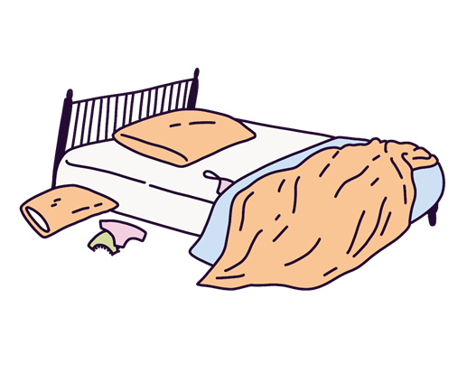
Sexy times

Slide 19
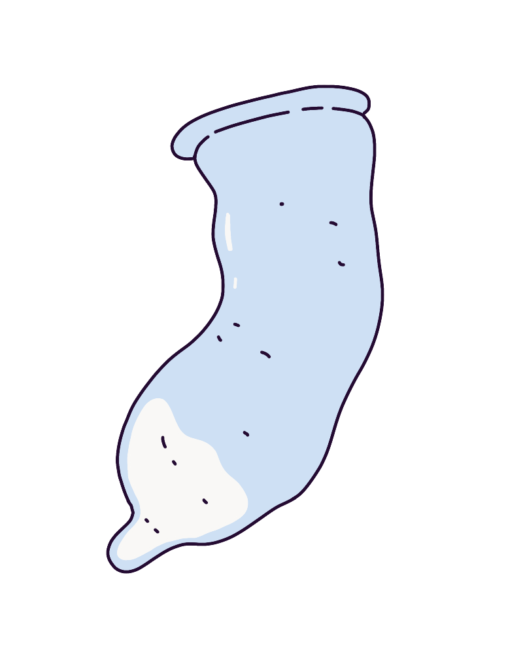
Hold base of condom while withdrawing

Slide 20
Why is it important to hold the base of the condom?
If the condom has ejaculate in it, what should we be careful about?

Slide 21
Remove the condom, tie a knot in it and put it in the bin

Slide 22
Why put a condom in the bin?
(and not in the toilet!)

