Slide 1
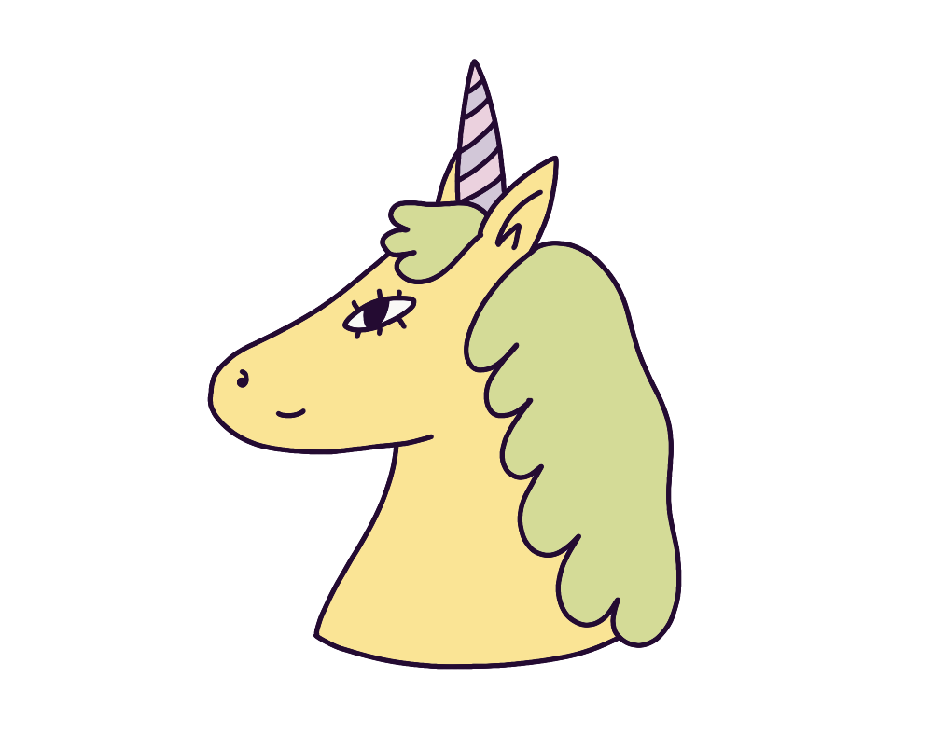
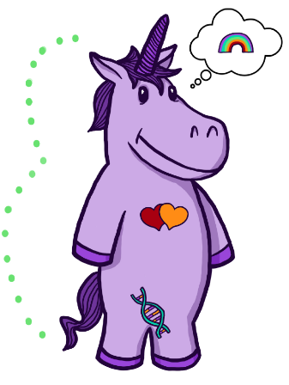

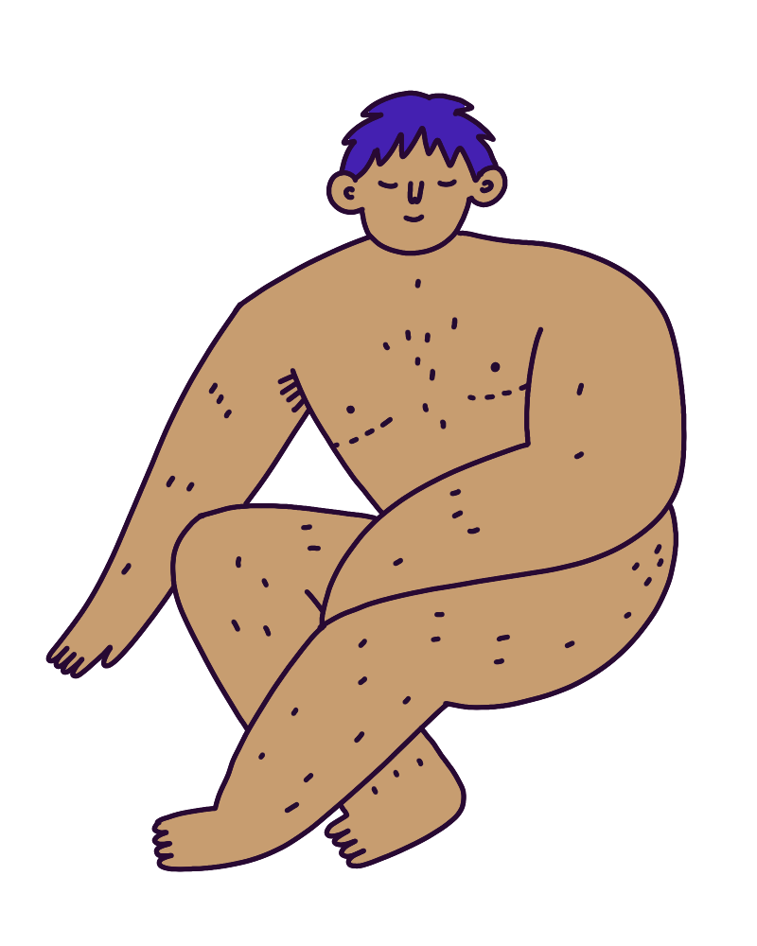


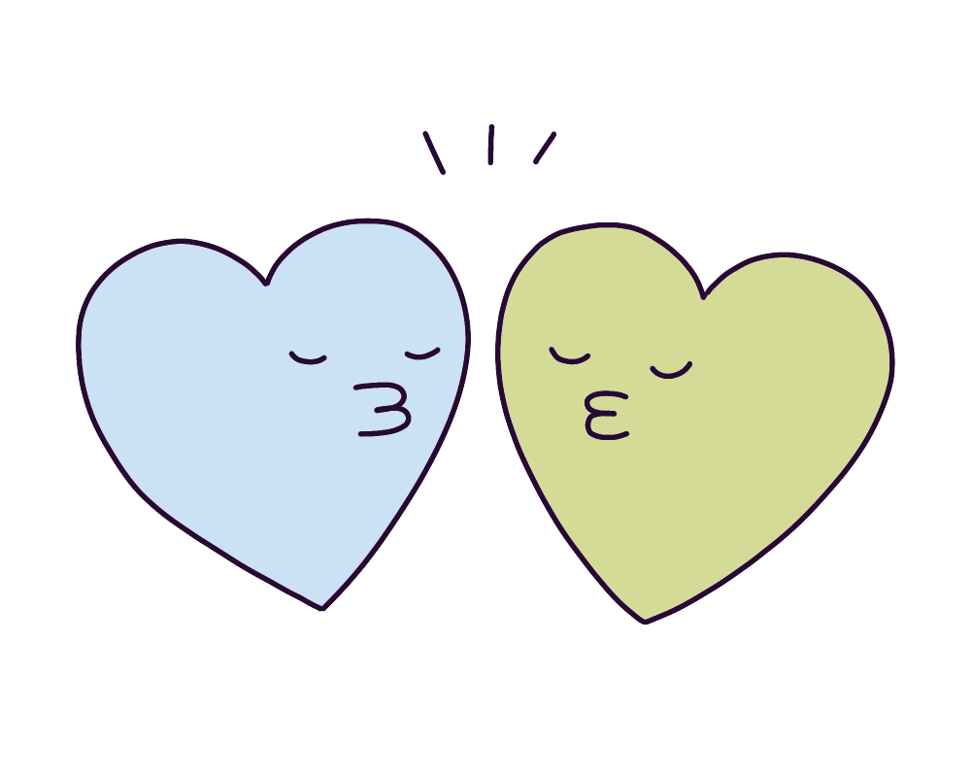

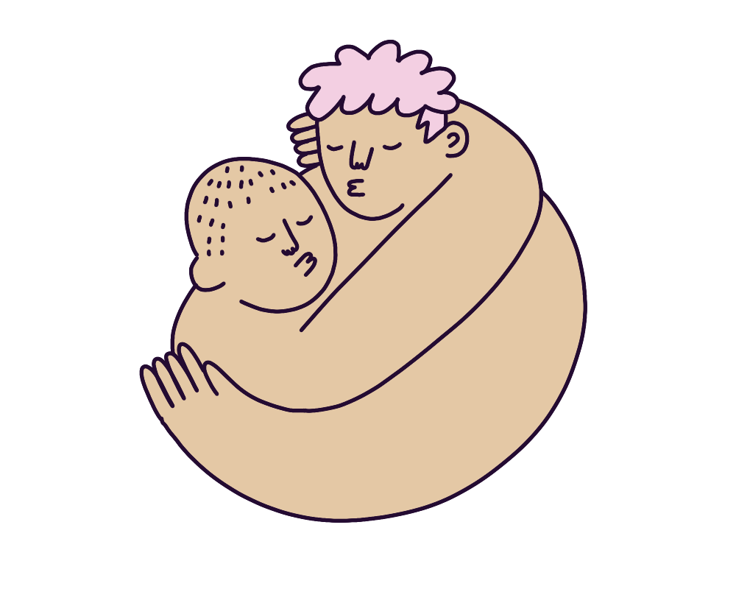
The gender unicorn
Gender identity
Gender expression
Sex assigned at birth
Physically attracted to
Emotionally attracted to
female / woman / girl
male/ man / boy
other genders
feminine
masculine
other
female / male/ intersex
women
men
other
women
men
other
Source: www.transstudent.org/gender

